Slide 1
Learning in Parametric Modeling 1 Session 08 & 09
Course : COMP6577 – Machine Learning
Effective Period : February 2020

Slide 2
Learning Outcome
LO2: Student be able to interpret the distribution of dataset using regression method

Slide 3
Outline
Parametric Modeling
Parameter estimation
Linear regression
Classification
Case Study

Slide 4
Parametric Modeling
Parametric models are mobilized to describe the available data.
In parametric modeling, the aforementioned functional dependence is defined via a set of unknown parameters, whose number is fixed. In contrast (non-parametric methods), unknown parameters may still be involved, yet their number depends on the size of the data set.
In parametric modeling, there are two possible paths to deal with the uncertainty imposed by the unknown values of the parameters. According to the first one, specific values are obtained and assigned to the unknown parameters. In the other approach, which has a stronger statistical flavor, parametric models are adopted in order to describe the underlying probability distributions, which describe the input and output variables, without it being necessary to obtain specific values for the unknown parameters

Slide 5
Parameter Estimation
The task of estimating the value of an unknown parameter vector, θ, has been at the center of interest in a number of application areas.
For example:
Given a set of data points, one must find a curve or a surface that “fits” the data. The usual path to follow is to adopt a functional form, such as a linear function or a quadratic one, and try to estimate the associated unknown coefficients so that the graph of the function “passes through” the data and follows their deployment in space as close as possible.

Slide 6
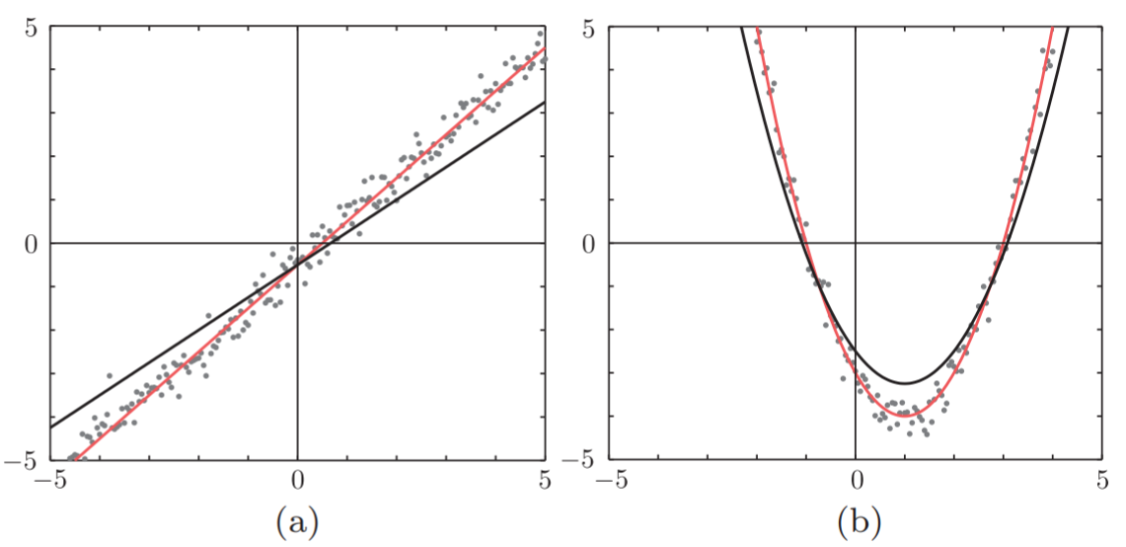
Parameter Estimation (2)
Fitting (a) a linear function and (b) a quadratic one. The red lines are the optimized ones.

Slide 7

Parameter Estimation (3)
The data lie in the space and are given to us as a set of points (y_{n}, x_{n}), n = 1, 2, ... , N. The adopted functional form for the curve corresponding to the figure (a) before is:
y = f_{θ} (x) = θ₀ + θ₁x
and for the case of figure (b) is:
y = f_{θ} (x) = θ₀ + θ₁x + θ₂x²
The unknown parameter vectors are θ = [θ₀ , θ₁]^{T} and θ = [θ₀ , θ₁, θ₂]^{T} , respectively. In both cases, the parameter values, which define the curves drawn by the red lines, provide a much better fit compared to the values associated with the black ones.

Slide 8



Parameter Estimation (4)
In both cases, the task comprises two steps:
Adopt a specific parametric functional form, which we reckon to be more appropriate for the data at hand.
estimate the values of the unknown parameters in order to obtain a “good” fit.
The task can be defined as follows:
Given a set of data points, (y_{n}, x_{n}), y_{n} ∈ , x_{n} ∈ , n = 1, 2, ... , N, and a parametric set of functions, find a function in , which will be denoted as f(·) := f_{θ∗} (·), such that given a value of x ∈ , f(x) best approximates the corresponding value y ∈

Slide 9
Parameter Estimation (5)
The value θ∗ is the value that results from the estimation procedure. The values of θ∗ that define the red line curves in Figures (a) and (b) in previous slides are:
θ∗ = [−0.5, 1]^{T} , θ∗ = [−3, −2, 1]^{T}
Having adopted a parametric family of functions, , one has to get an estimate for the unknown set of parameters. To this end, a measure of fitness has to be adopted. The more classical approach is to adopt a loss function, which quantifies the deviation/error between the measured value of y and the predicted one using the corresponding measurements x, as in f_{θ}(x).

Slide 10


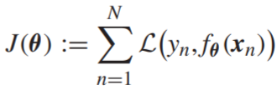
Parameter Estimation (6)
In a more formal way, a nonnegative (loss) function is adopted:
and compute θ∗ so as to minimize the total loss, or as we say the cost, over all the data points, or
Where , assuming that a minimum exists.
Note that, in general, there may be more than one optimal values θ∗, depending on the shape of J(θ).

Slide 11

LS Loss Function
The LS loss function is credited to the great mathematician Carl Frederich Gauss, who proposed the fundamentals of the LS method in 1795 at the age of eighteen.
However, it was Adrien-Marie Legendre who first published the method in 1805, working independently.
Gauss published it in 1809. The strength of the method was demonstrated when it was used to predict the location of the asteroid Ceres.
Since then, the LS loss function has “haunted” all scientific fields, and even if it is not used directly, it is, most often, used as the standard against which the performance of more modern alternatives are compared.

Slide 12
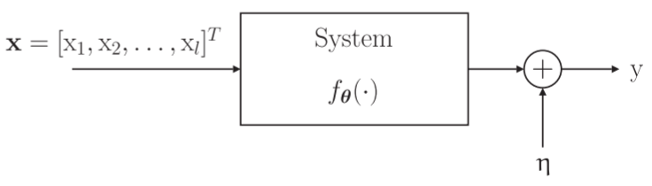
Linear Regression
In statistics, the term regression was coined to define the task of modeling the relationship of a dependent random variable, y, which is considered to be the response of a system, when this is activated by a set of random variables, x₁, x₂, ... , x_{l}, which will be represented as the components of an equivalent random vector x. The relationship is modeled via an additive disturbance or noise term, η (unobserved random variable).
This is the block diagram of the process, which relates the involved variables.

Slide 13
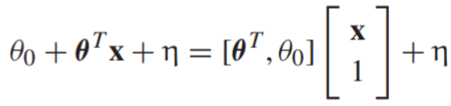
Linear Regression (2)
The goal of the regression task is to estimate the parameter vector, θ, given a set of measurements, (y_{n}, x_{n}), n = 1, 2, ... , N, that we have at our disposal. This is also known as the training data set, or the observations. The dependent variable is usually known as the output variable and the vector x as the input vector or the regressor. If we model the system as a linear combiner, the dependence relationship is written as y = θ₀ + θ₁x₁ +···+ θ_{l}x_{l} + η = θ₀ + θ^{T} x + η
The parameter θ₀ is known as the bias or the intercept. Usually, this term is absorbed by the parameter vector θ with a simultaneous increase of the dimension of x by adding the constant 1 as its last element. Indeed, we can write:

Slide 14



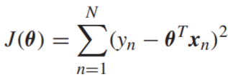
Linear Regression (3)
the regression model will be written as y = θ^{T} x + η and, unless otherwise stated, this notation means that the bias term has been absorbed by θ and x has been extended by adding 1 as an extra component.
Because the noise variable is unobserved, we need a model to be able to predict the output value of y, given the value x.
In linear regression, we adopt the following prediction model:
Using the LS loss function, the estimate is set equal to θ∗, which minimizes the square difference between and y_{n}, over the set of the available observations; that is, by minimizing, with respect to θ, the cost function

Slide 15
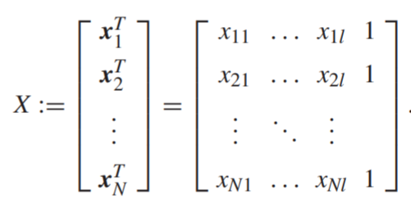
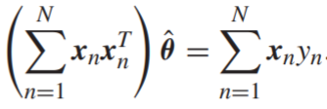



Linear Regression (4)
Taking the derivative (gradient) with respect to θ and equating to the zero vector, 0, we obtain:
Then, it is straightforward the equation can be written as
, where
and the LS estimate is given by
that (X^{T}X)⁻¹ exists

Slide 16
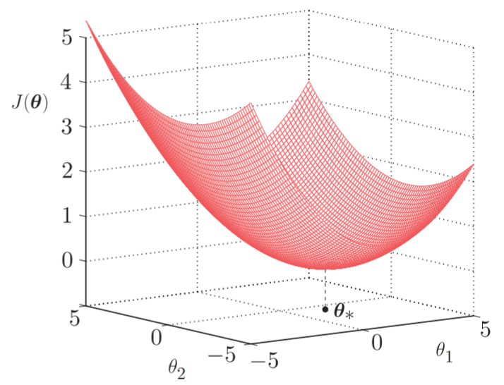
Linear Regression (5)
This is a major advantage of the LS loss function, when applied to a linear model. Moreover, this solution is unique, provided that the (l + 1) × (l + 1) matrix X^{T}X is invertible.
The uniqueness is due to the parabolic shape of the graph of the LS cost function. The figure below is the illustration of two-dimentional space. The least-squares loss function has a unique minimum at the point θ∗

Slide 17
Classification
Classification is the task of predicting the class to which an object, known as pattern, belongs. The pattern is assumed to belong to one and only one among a number of a priori known classes.
Each pattern is uniquely represented by a set of measurements, known as features. One of the early stages in designing a classification system is to select an appropriate set of feature variables. These should “encode” as much class-discriminatory information, so that, by measuring their value for a given pattern, to be able to predict, with high enough probability, the class of the pattern.
Selecting the appropriate set of features for each problem is not an easy task and it comprises one of the most important areas within the field of Pattern Recognition

Slide 18


Classification (2)
To formulate the task in mathematical terms, each class is represented by the class label variable, y. For the simple two-class classification task, this can take either of two values, depending on the class, e.g., 1, −1, or 1, 0, etc. Then, given the value of x, corresponding to a specific pattern, its class label is predicted according to the rule,
where is a nonlinear function that indicates on which side of the decision surface, f(x) = 0, x lies.

Slide 19
Classification (3)
So, is the classification any different from the regression task?
they are similar, yet different
Note that in a classification task, the dependent variables are of a discrete nature, in contrast to the regression, where they lie in an interval. This suggests that, in general, different techniques have to be adopted to optimize the parameters.
For example, the most obvious choice for a criterion in a classification task is the probability of error. However, in a number of cases, one can attack both tasks using the same type of loss functions. Even if such an approach is adopted, in spite of the similarities in their mathematical formalism, the goals of the two tasks remain different.

Slide 20


Classification (4)
In the regression task, the function f(·) has to “explain” the data generation mechanism. The corresponding surface in the (y, x) space should develop so as to follow the spread of the data in the space, as close as possible.
In contrast, in classification, the goal is to place the corresponding surface f(x) = 0, in , so as to separate the data that belong to different classes as much as possible. The goal of a classifier is to partition the space where the features vectors lie into regions and associate each region with a class.

Slide 21
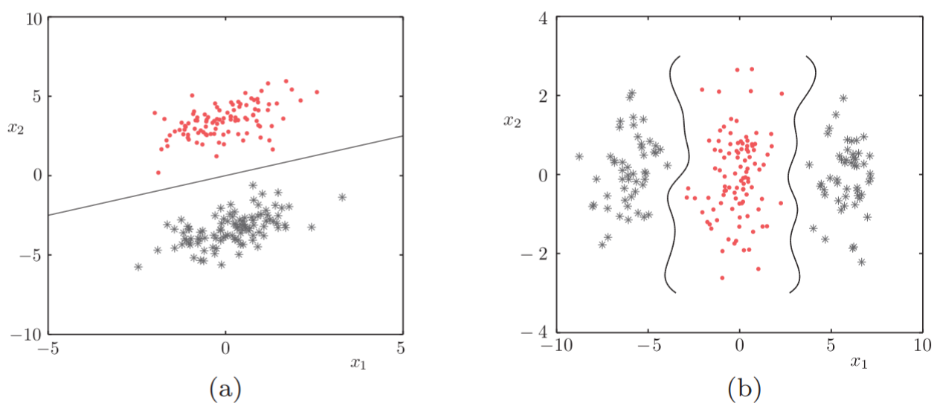
Classification (5)
Example of two cases of classification tasks. The first one is an example of two linearly separable classes, where a straight line can separate the two classes, and the second one of two nonlinearly separable classes, where the use of a linear classifier would have failed to separate the two classes.

Slide 22

Classification (Example)
We are given a set of training patterns, x_{n} ∈ , n = 1, 2, ... , N, that belong to either of two classes, say ω₁ and ω₂. The goal is to design a hyperplane f(x) = θ₀ + θ₁x₁ +···+ θ_{l}x_{l} = θ^{T} x where we have absorbed the bias θ₀ in θ and extend the dimension of x= 0. Our aim is to place this hyperplane in between the two classes.
Obviously, any point lying on this hyperplane scores a zero, f(x) = 0, and the points lying on either side of the hyperplane score either a positive (f(x) > 0) or a negative value (f(x) < 0), depending on which side of the hyperplane they lie. Therefore, we should train the classifier so that the points from one class score a positive value and the points of the other a negative one.

Slide 23
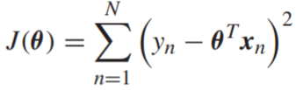
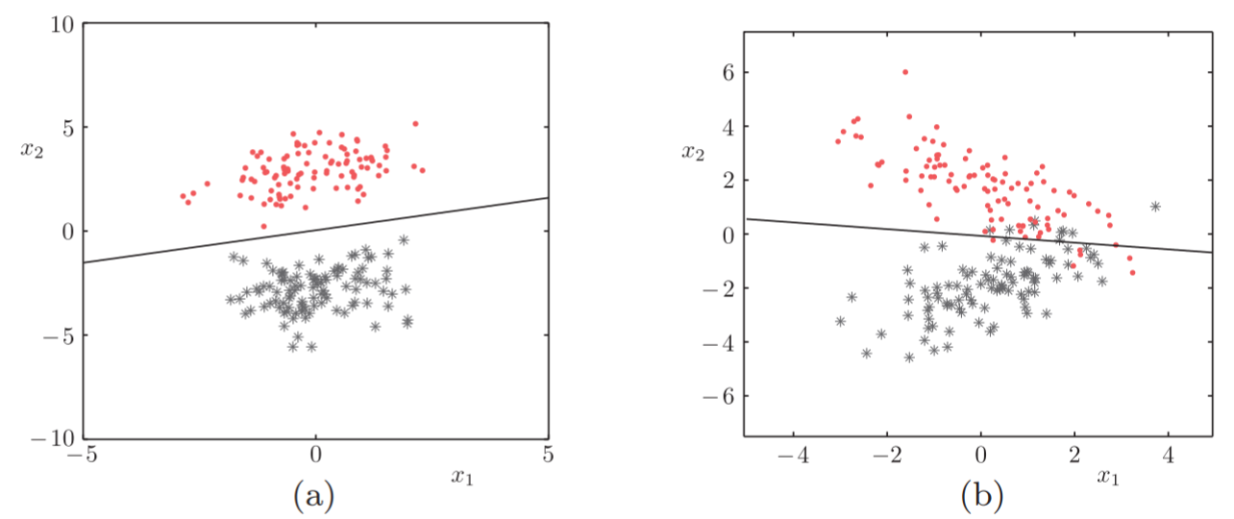
Classification (Example)
This can be done, for example, by labeling all the points from class, say ω₁, with y_{n} = 1, ∀_{n} : x_{n} ∈ ω₁, and all the points from class ω₂ with y_{n} = −1, ∀_{n} : x_{n} ∈ ω₂. Then the LS loss is mobilized to compute θ so as to minimize the cost
This figure shows the resulting LS classifiers for two cases of data.

Slide 24
Classification (Example)
In case figure (b), the classifier cannot classify correctly all the data points. Our desire to place all the data, which originate from one class, on one side and the rest on the other cannot be satisfied. All that our LS classifier can do is to place the hyperplane so that the sum of squared errors, between the desired (true) values of the labels, y_{n}, and the predicted outputs, θ^{T} x_{n}, are a minimum.
It is mainly for cases such as overlapping classes, which are usually encountered in practice, where one has to look for an alternative to the LS criteria and methods, in order to serve better the needs and the goals of the classification task.

Slide 25
Case Study
Given data of Singapore Airbnb which can be downloaded in this link
https://www.kaggle.com/jojoker/singapore-airbnb
By using the data from the link above, you can simulate linear regression and classification. You can try and choose the attributes yourself.

Slide 26
End of Session 08 & 09

Slide 27
References
Sergios Theodoridis. (2015). Machine Learning: a Bayesian and Optimization Perspective. Jonathan Simpson. ISBN: 978-0-12-801522-3. Chapter 3.
Aurélien Géron. (2017). 01. Hands-on Machine Learning with Scikit-Learn and Tensorflow. O’Reilly Media, Inc..LSI: 978-1-491-96229-9. Chapter 3.
https://www.kaggle.com/jojoker/singapore-airbnb

